Slide 1
The Mission: The Phoenix offers a free sober active community to individuals who have suffered from a substance use disorder and to those who choose a sober life. Using a peer support model, we help members heal and rebuild their lives while also striving to eliminate stigma around recovery.
Together we…
RISE & RECOVER & LIVE

Slide 2
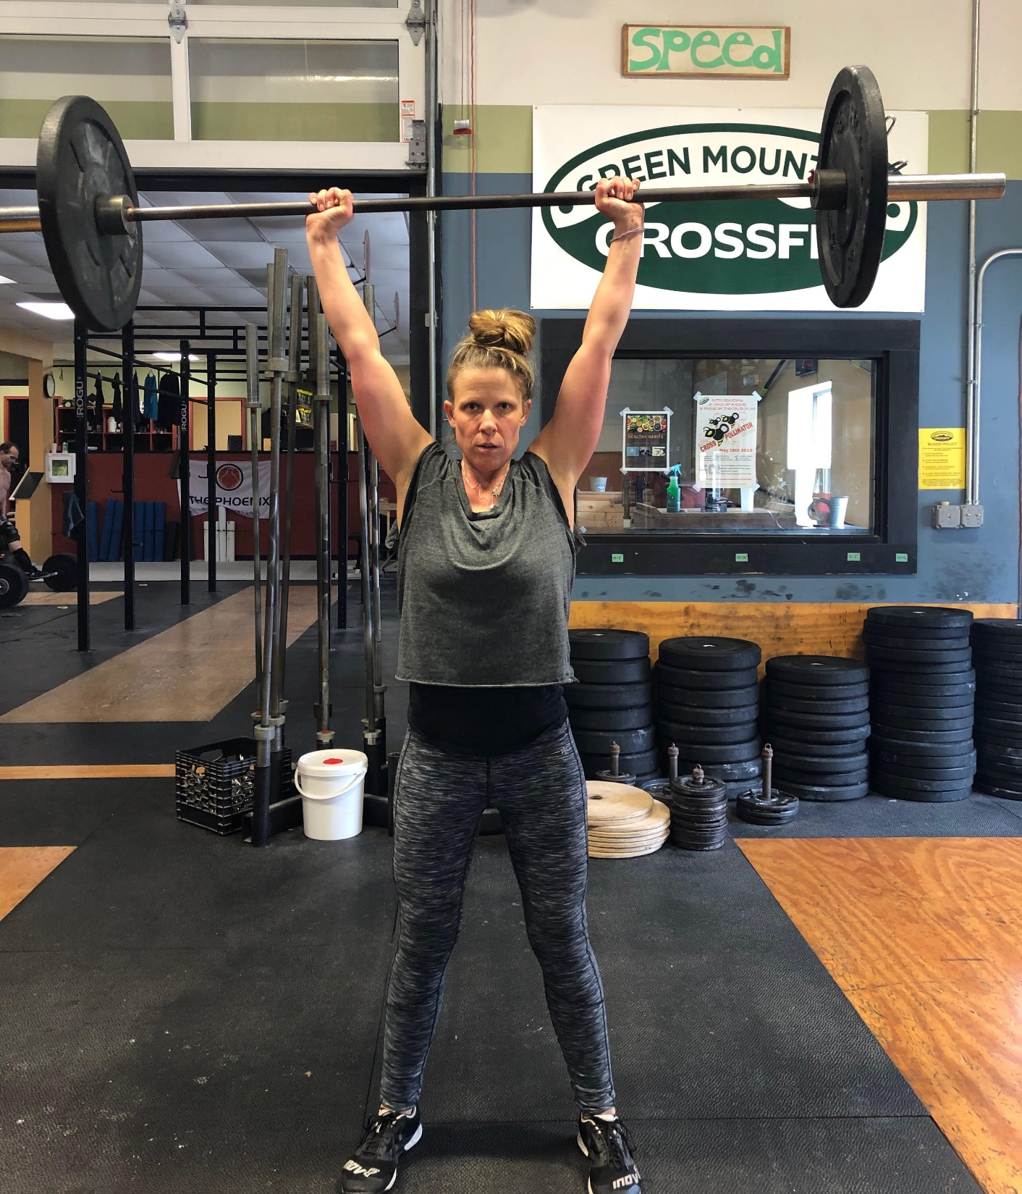
PHOENIX PURPOSE
Phoenix answers the question of “what’s next?” for those leaving treatment or pursuing a sober life by fostering a free, sober, active community where individuals can find a healthy and positive environment.

Slide 3
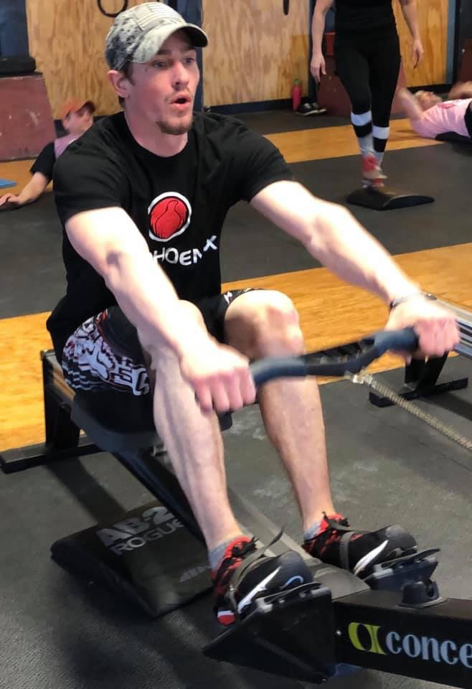
PHOENIX MODEL
PROVIDE FREE AND CONSISTENT ACCESS FOR INDIVUALS IN RECOVERY OR LIVING A SOBER LIFESTYLE TO FITNESS PROGRAMS LIKE CROSSFIT, STRENGTH TRAINING, BIKING, ROCK CLIMBING AND YOGA CONSISTENT WITH PHOENIX COMMUNITY STANDARDS AND CORE VALUES. 48 HOURS OF CONTINUOUS SOBRIETY REQUIRED.

Slide 4
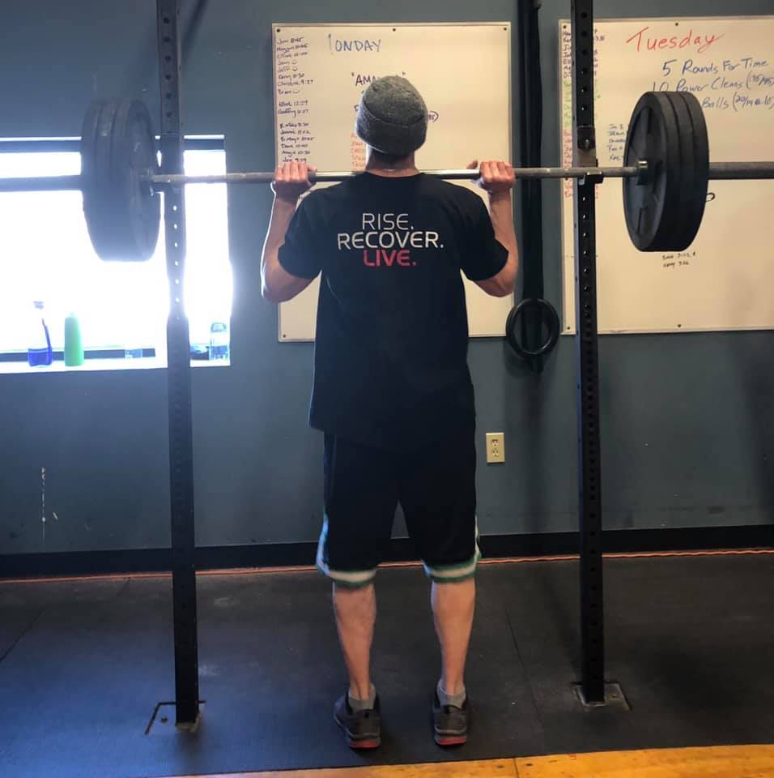
HISTORY SNAPSHOT
EST. 2006 –FOUNDER SCOTT STRODE
7 ‘BRICK AND MORTAR’ MODELS IN URBAN LOCATIONS ACROSS USA
27,000 INDIVIDUALS IN RECOVERY SERVED
INCREASED DEMAND LEAD TO FLEXIBLE, LOW COST MODEL THAT INCLUDES:
LOCAL GYM/FITNESS FACILITY DONATE TIME/SPACE
CLASSES LEAD BY PHOENIX TRAINED INSTRUCTOR CERTIFIED IN RESPECTIVE DISCIPLINE
VOLUNTEER PEER SUPPORT AT EACH CLASS
36 FLEXIBLE MODEL SITES CURRENTLY OPERATING, INCLUDING 4 IN VERMONT

Slide 5
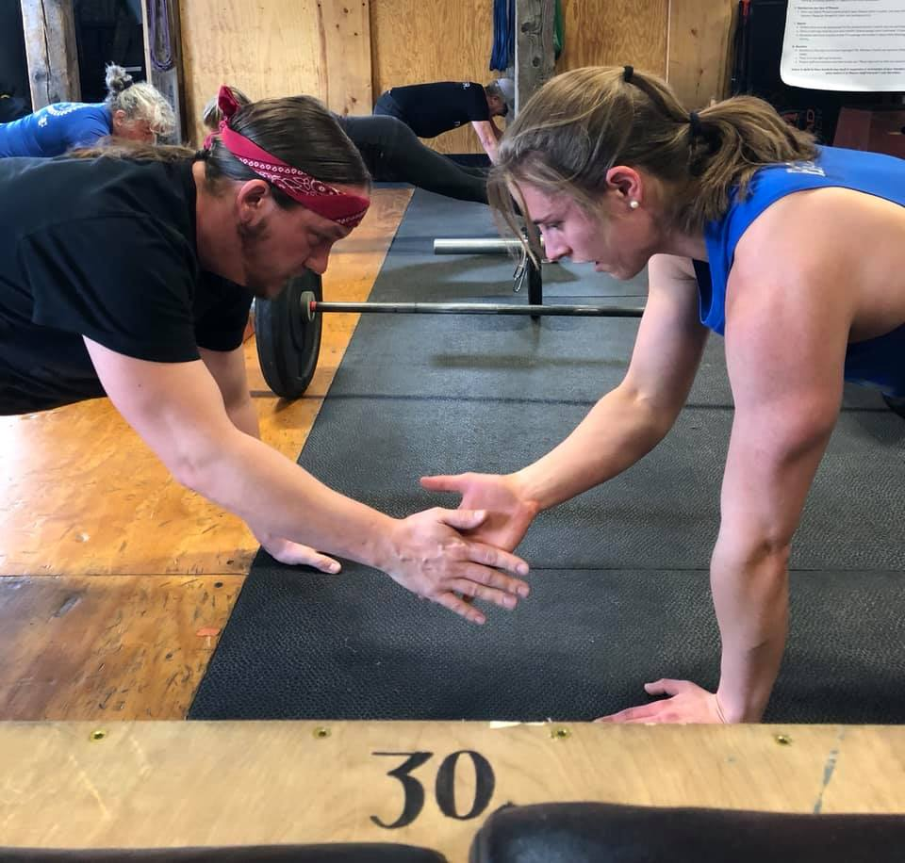
PHOENIX VERMONT 1ST TEAM
DEC. 2018 1ST PHOENIX VT SITE LAUNCH SETTING NATIONAL RECORD ATTENDANCE.
CHAMPION-
GREEN MOUNTAIN UNITED WAY COMMUNITY/PARTNER/VOLUNTEER CONNECTIONS & ADVOCACY
DRIVER-
CENTRAL VT SUBSTANCE ABUSE PUBLIC OUTREACH/CLIENT ENGAGEMENT
INSTRUCTOR/FACILITY-
GREEN MOUNTAIN CROSSFIT

Slide 6
THE PHOENIX VT COMMUNITY
EACH SITE HOSTS 1 FREE CLASS PER WEEK
BERLIN-GREEN MNT CROSSFIT CENTRAL
BARRE-23 SUMMER ST. WELL SPACE (WCMH)
BARRE- IMAGINE YOGA
HYDE PARK-GREEN MNT CROSSFIT NORTH
BURLINGTON-CROSSFIT BURLINGTON

Slide 7
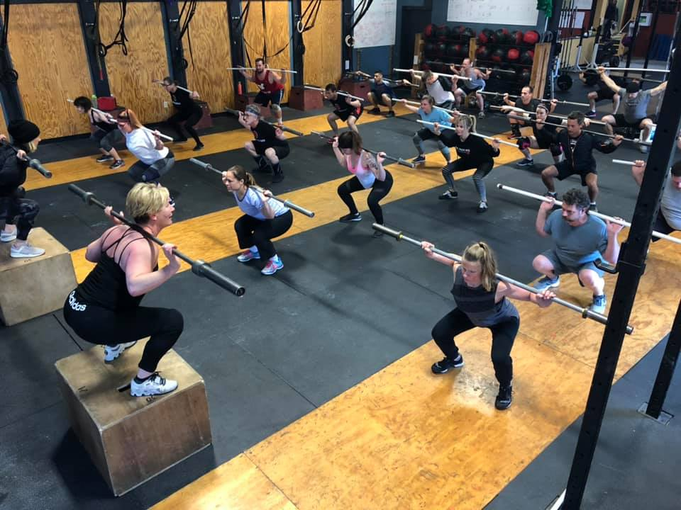
WHAT WE SEE
INCREASING NUMBERS OF PEOPLE IN RECOVERY FINDING A NEW IDENTITY AND RESILIENCE THROUGH AN ACTIVE AND SUPPORTIVE COMMUNITY.
AV. CLASS 15-25 PARTICIPANTS
AV. VOLUNTEER BASE PR CLASS-5
AV. AGE OF PARTICIPANTS 18-30 YRS OLD
1-2 NEW MEMBERS PR WK/PR SITE
PEER TO PEER MENTORING
WANT MORE!

Slide 8
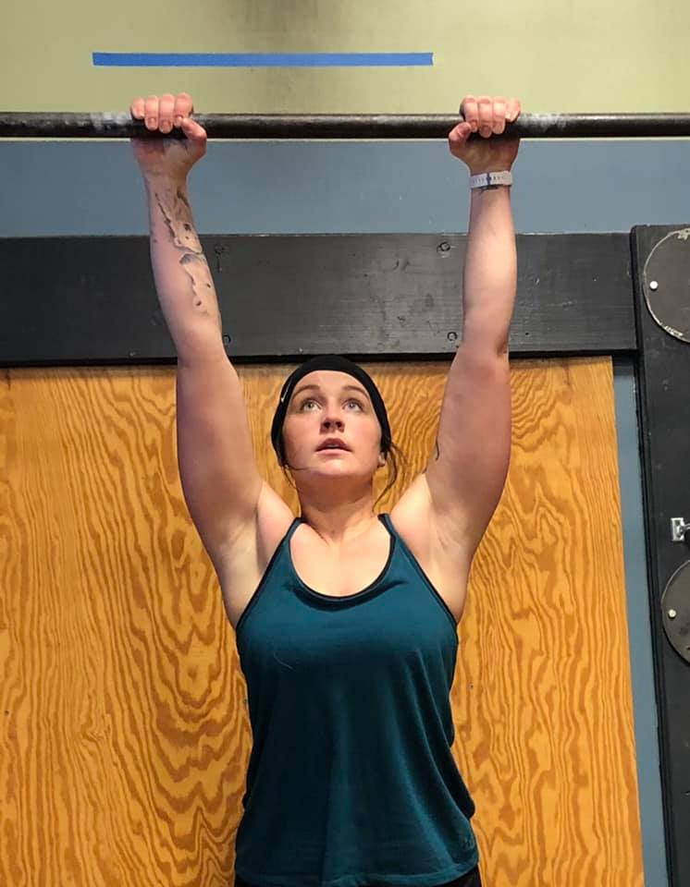
WHAT WE HEAR
“Today was my first try at CrossFit and I got such great support and tough love from the coaches. So excited to be a part of this group and bring my recovery to next level with wellness and confidence!”
“Such a great community of recovery. These people are nothing short of a miracle on any given day. Its such an honor to feel belonging, to laugh, to sweat, and to refine these God-given bodies. Just how they were intended - strong and sober. A true gem in my recovery.”
“My new addiction is CrossFit. Thank you Phoenix VT community!”
”I leave each week feeling stronger and more grateful for my recovery! The crew is my family, and we help each other dig deep and reach the parts of ourselves that hold our inner strength.”
“I lost who I was. I lost everything. I lost my family. I lost my friends. You name it, I lost it. CrossFit and Phoenix VT showed me what I was capable of and that I am still worth something.”

Slide 9
CONNECT WITH THE COMMUNITY
Phoenix Northeast Region Phoenix- Vermont
Chris Daggett Tawnya Kristen
chris@thephoenix.org tkristen@gmunitedway.org
Class-Event-Photos-Media
facebook.com/ThePhoenixVermont
www.thephoenix.org

Slide 10
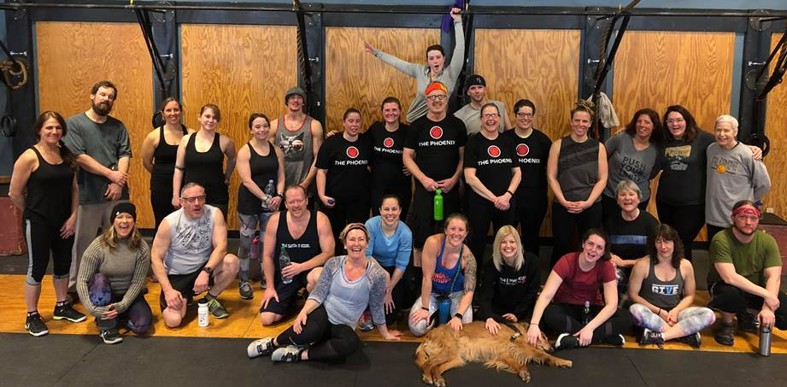
THANK YOU!

